Slide 1
Advanced Design Methods (MDO, KBE) AE4233
Dr.ir. G. La Rocca
Dr.ir. H.A. Visser
Ir. D. Steenhuizen
Dr. A. Elham
Flight Performance & Propulsion Group (FPP)
On parameterization techniques

Slide 2
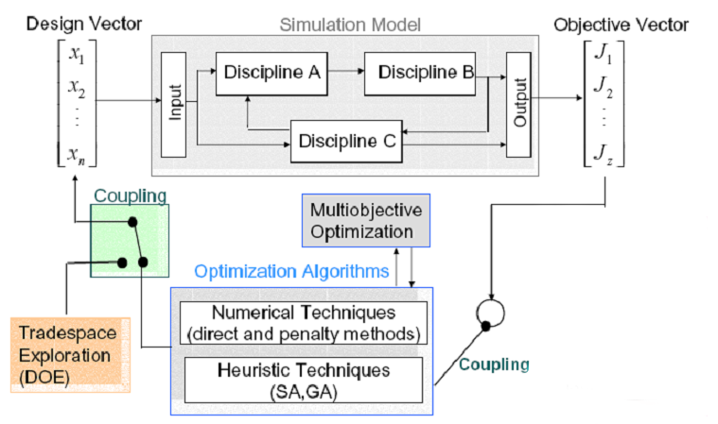
Parameterisation
Parameterisation is the process of deciding and defining the parameters necessary for a complete or relevant specification of a model or geometric object.

Slide 3
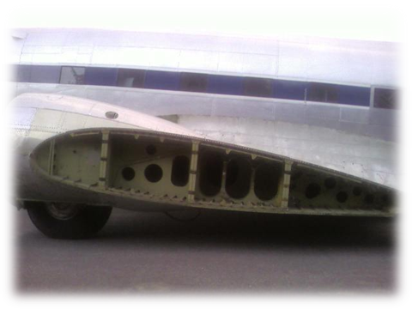
To enable the translation of the real system into a mathematical representation that is suitable for (multi)disciplinary analysis
Why parameterisation?
Aerodynamic
model
?
L,D
(lift, drag)
?
Structural
model
W
(weight)

Slide 4
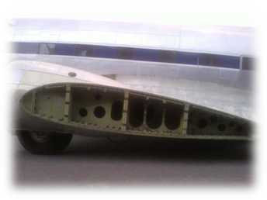
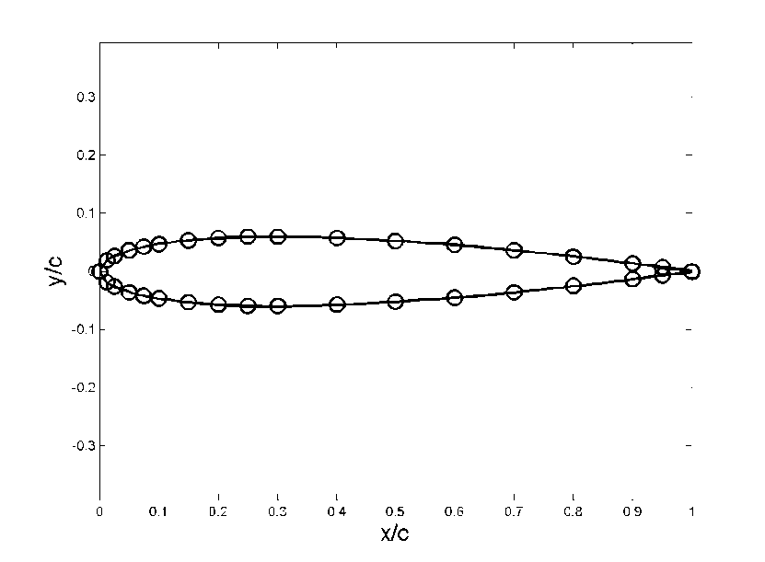
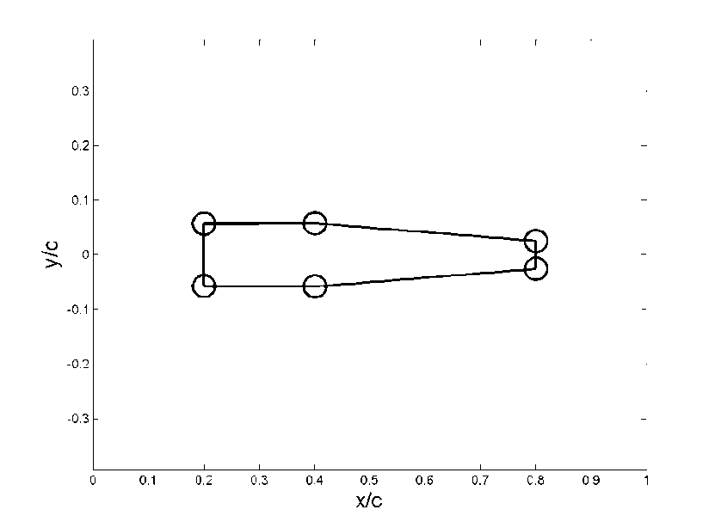
Why parameterisation?
Eventually, I have to make sure that my disciplinary tools “understand” how the real system looks alike, in order to analyse or predict its performance.
Same product, different disciplinary views
Aerodynamic model
e.g. XFoil
Structural model
e.g. Hollow beam model

Slide 5
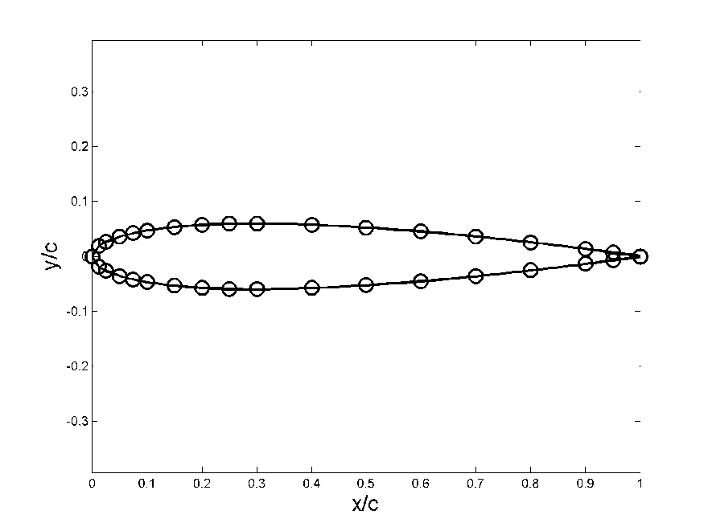
The disciplinary “views”
A disciplinary view is an abstraction of the real system, where all the not relevant features to the given disciplinary analysis (tool) have been removed.
An example of aerodynamic model and its parameterization:
34 points (x,y)
68 parameters to uniquely define this geometry

Slide 6
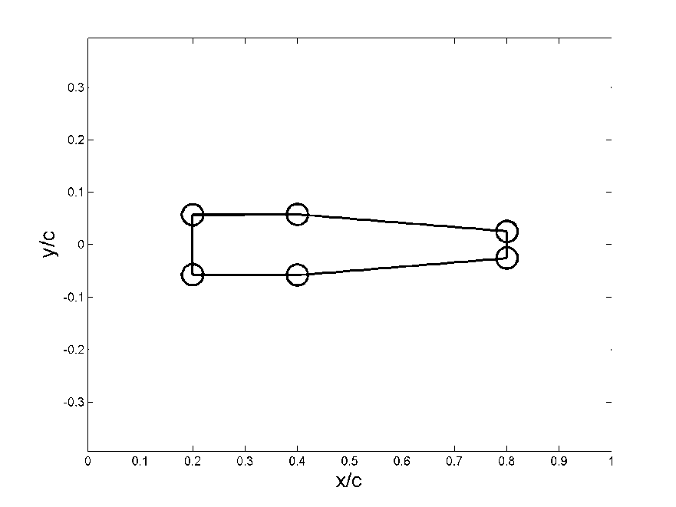
The disciplinary “views”
An example of structural model and its parameterization:
6 variables representing the areas of spar and stiffener flanges
12 variables representing the locations of the flanges
6 variables representing the thickness of upper and lower skin panels and front and back spar web
Areas and locations
→ a total of 24 parameters to uniquely define this geometry

Slide 7
Requirements for parameterization
How can we model the disciplinary views consistently, effectively and efficiently?
Consistently: it is about guaranteeing that each disciplinary model is a representation (an abstraction) of the same original geometry
Efficiently: it is about selecting the minimum number of parameters required to build an adequate system abstraction
Effectively: it is about selecting the right type of parameters that allow:
  to capture all the required features of the system to be abstracted
  to generate usable system variants when changing the parameter values

Slide 8
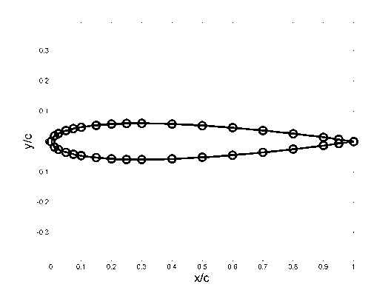

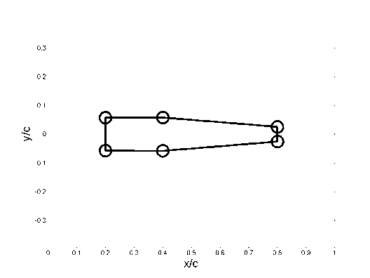
Generation of consistent disciplinary “views”
L,D
W
A so called product “meta model” is required, from where to extract different but consistent disciplinary views!
In case of complex products, KBE is possibly the best way to go!

Slide 9
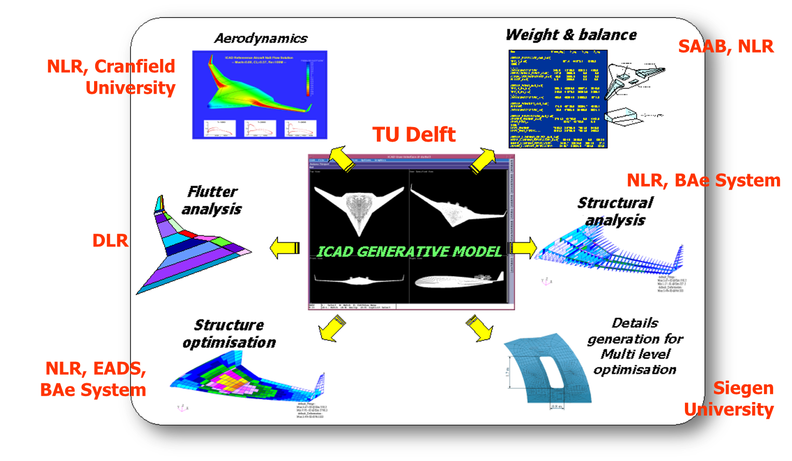
Generation of consistent disciplinary “views”
Example of a BWB aircraft metamodel developed using ICAD (a commercial KBE system), to support distributed multidisciplinary analysis

Slide 10
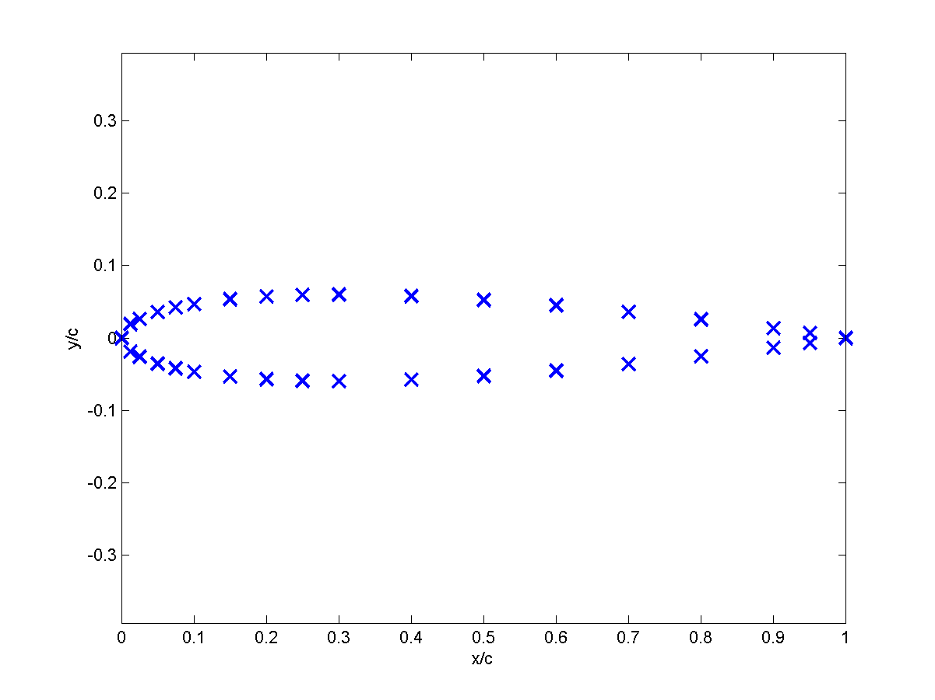
Example of airfoil parameterization by means of Cartesian coordinates
Generation of efficient and effective “views”
Upper Surface
x/c y/c
------------------
0.0000 0.0000
0.0125 0.0189
0.0250 0.0261
0.0500 0.0355
0.0750 0.0420
0.1000 0.0468
0.1500 0.0534
0.2000 0.0573
0.2500 0.0593
0.3000 0.0599
0.4000 0.0578
0.5000 0.0526
0.6000 0.0452
0.7000 0.0360
0.8000 0.0254
0.9000 0.0135
0.9500 0.0069
1.0000 0.0000
Lower Surface
x/c y/c
-------------------
0.0000 -0.0000
0.0125 -0.0189
0.0250 -0.0261
0.0500 -0.0355
0.0750 -0.0420
0.1000 -0.0468
0.1500 -0.0534
0.2000 -0.0573
0.2500 -0.0593
0.3000 -0.0599
0.4000 -0.0578
0.5000 -0.0526
0.6000 -0.0452
0.7000 -0.0360
0.8000 -0.0254
0.9000 -0.0135
0.9500 -0.0069
1.0000 -0.0000
A classical in literature

Slide 11
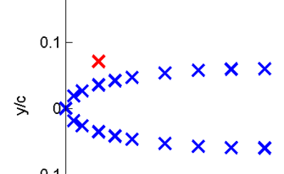
Generation of efficient and effective “views”
Although the Cartesian coordinates method seems to offer a very large degree of freedom…
.. what if I (or the optimizer) change just one point coordinate?
No longer a feasible shape!
Consequently, the “search method” has to try a large number of unfeasible configurations, thereby wasting a lot of time and computational resources.
A lot of design variables are required to describe the product

Slide 12
Generation of efficient and effective “views”
What if I (or the optimizer) need to increase the model accuracy?
Where and how to generate additional points?
Via some kind of interpolation? It seems impractical!
Indeed, the Cartesian coordinate set (or cloud of points for surfaces) is generally a means to exchange and communicate a given airfoil shape. Not a suitable way to parameterize it for design optimization!

Slide 13
Parameterization for MDO
An appropriate parameterization method to support MDO will…
Restrict all possible shapes to shapes of interest.
  These shapes solutions stem from experience. In this way the search method does not waste time with unrealistic design options.
Provide enough flexibility to model all the feasible options of interest to the designer.
  An inflexible parameterization leads to a-priori limitation of the design space
Required step: from discrete points to mathematically defined curves and surfaces
As a matter of fact, the point coordinates are generally the result of some mathematical function, evaluated at discrete points

Slide 14


Mathematical definition of curves & surfaces
Curve is one dimensional. A location on this curve is described by one parameter
Surface is two dimensional. A location on this surface is described by two parameters
However...
To describe a curve or surface, N parameters can be used.
These N parameters become the geometric variables for the optimization
Choosing for a particular curve/surface parameterisation approach allows controlling the type of curves/surfaces variants that can be generated and investigated by the “search method”

Slide 15
Benefits of using curves
The choice of parameterization allows to “design” the properties of the curve (i.e., general shape, curvature), instead of the actual geometry
Curves are defined on a parameter interval: so increasing numerical accuracy by increasing the number of elements increases the accuracy of the geometry in the model, without increasing the number of design parameters
Curve parameterization methods are used in aeronautics at least from the 30ies: NACA airfoil families.
Different families were defined using mathematical functions that used few parameters, such as thickness and curvature.

Slide 16
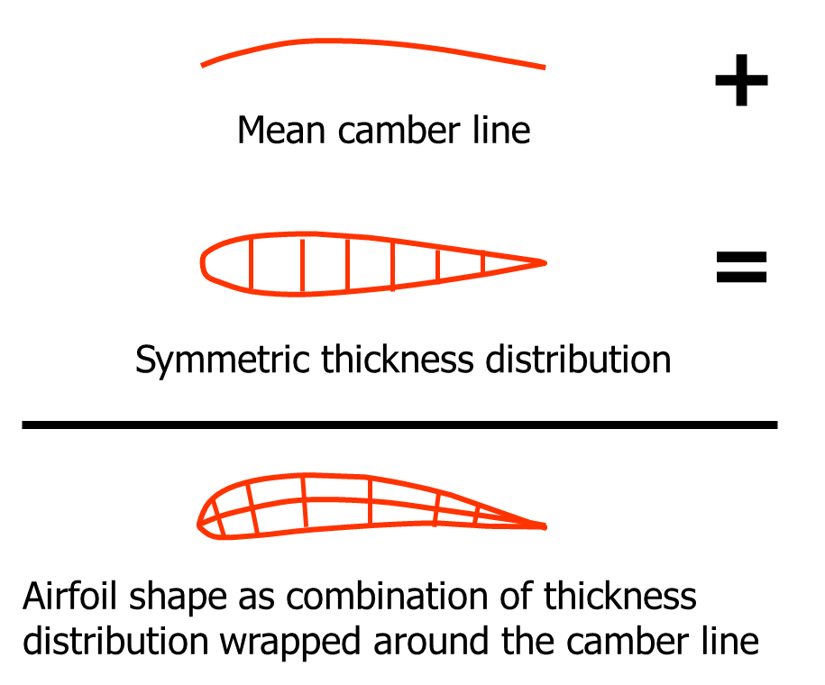
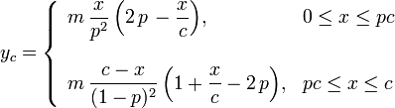
A real classic: NACA 4-digit series
Camber-distribution:
Thickness distribution:
where: m is the maximum camber, p is the location of maximum camber and t is the maximum thickness)

Slide 17
Need for new parameterizations
The above mentioned airfoil parameterisation techniques have proved their value for their intended purposes.
However, with the current state of technology, they are somehow outdated.
Still, there is a need for suitable parameterisation techniques to describe smoothly curved aerodynamic surfaces.
What else is out there?

Slide 18
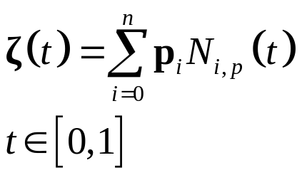
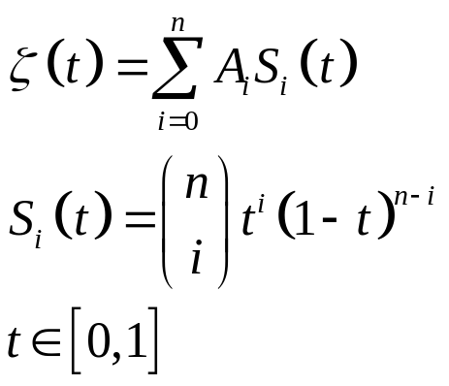
Curve parameterization techniques
Some useful mathematical formulations for curves:
B-splines and Bezier curves
Bernstein polynomials
Others: Chebychev Polynomials, Polynomials, NURBS
Parameters

Slide 19
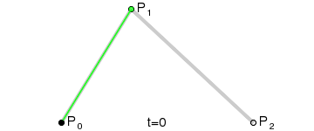
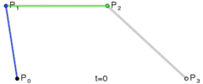
Bezier Curves
They are defined by a set of control points P. These points define a convex hull (Bezier polygon), wherein the curve is generally located.
The first and last control points are the start and the end point of the curve. The other control points, generally, do not lie on the curve.
The control points contiguous to the first and last control points define the derivatives at the start and the end of the curve
The degree (or order) of the Bezier curve is equal to the number of control points minus one (in this example 2 and 3)

Slide 20
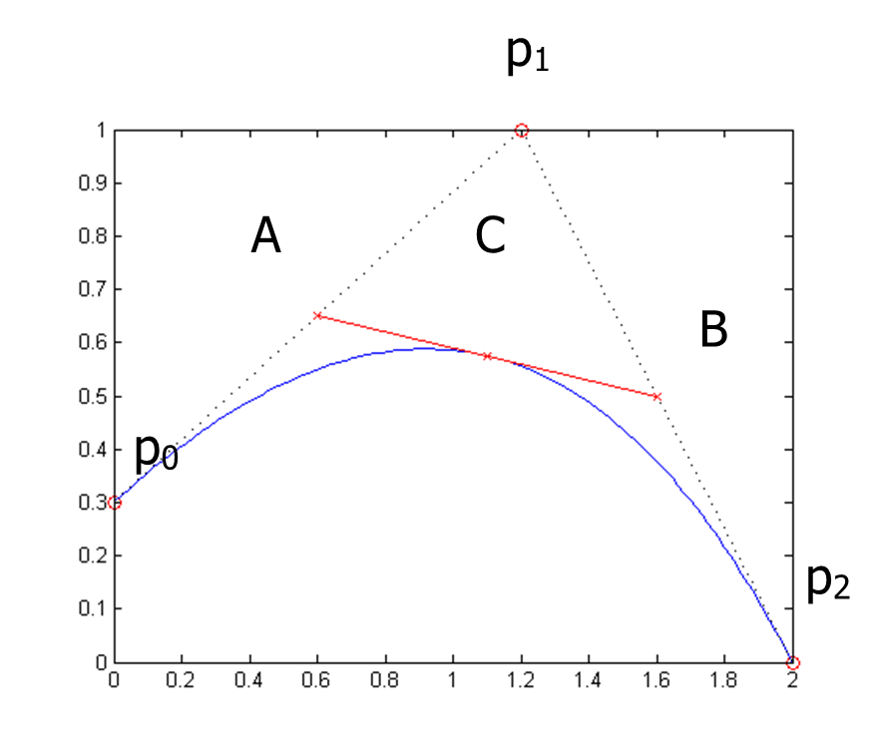
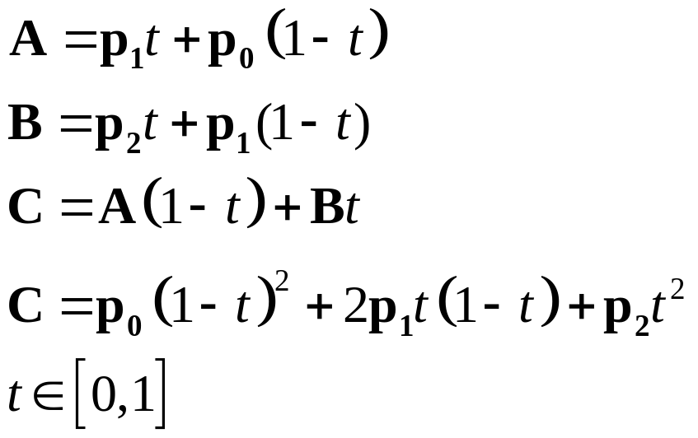

Bezier Curves
Example of a quadratic Bezier curve (i.e., 3 control points):
Bernstein polynomials
Control points
Notes:
The curve is built by computing point C at the required value of t.
Point C is actually computed as linear interpolation of point A and B.
Point A is computed at the given t value as linear interpolation between control point p0 and p1.
Point B is computed at the given t value as linear interpolation between control point p1 and p2.
As a matter of fact, a Bezier curve is a linear combination of Bernstein polynomials.

Slide 21
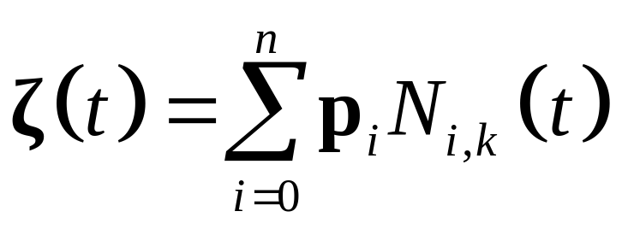
B-splines
A B-spline is a combination of more Bezier-curves.
A B-spline allows modeling more sophisticated curves, without the need of using a single high degree Bezier-curve, hence reducing computation time.
For more information see reader page 148 and further

Slide 22

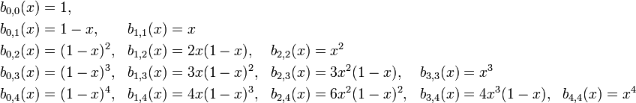
Bernstein polynomials
Bernstein polynomials are so defined, where n indicate the grade:
These are the first polynomials for grade 0 – 4:
The number of basis polynomials per grade n is n+1

Slide 23
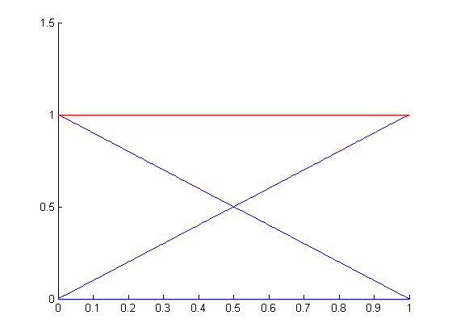
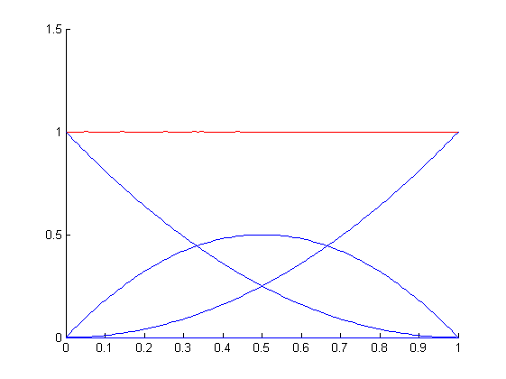
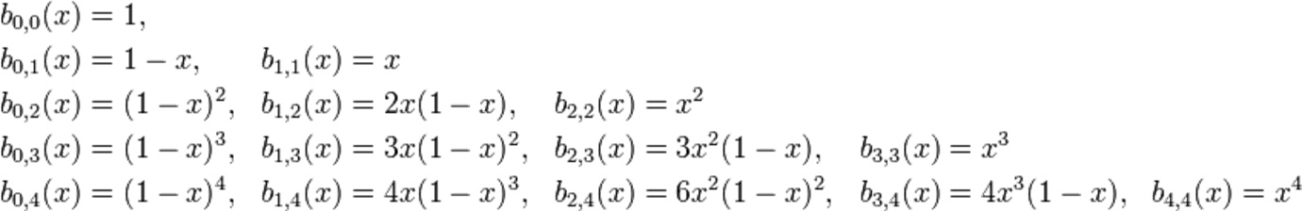
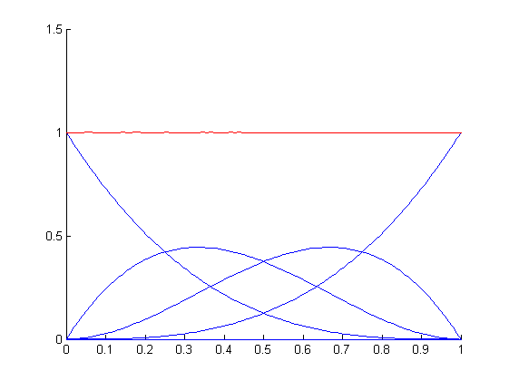
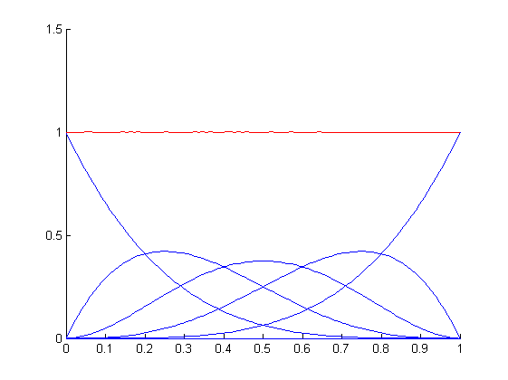
Properties of Bernstein polynomials
The sum of Bernstein polynomials is always 1 over the complete domain of parameter t (unless the use of scaling factors A)
A = [1 1]
A = [1 1 1]
A = [1 1 1 1]
A = [1 1 1 1 1]
Notes:
General smoothness of the function is dependent on its degree (higher degrees create waviness)
Continuously differentiable curves can be obtained for any order of the Bernstein polynomials and any value of the scaling factors

Slide 24
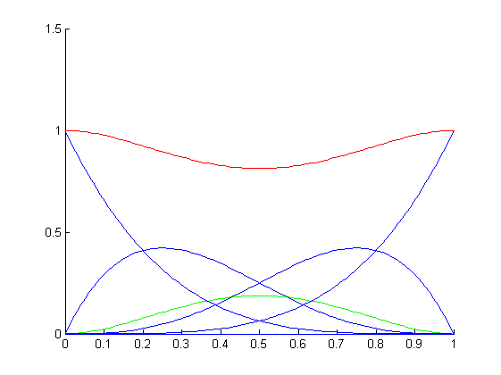
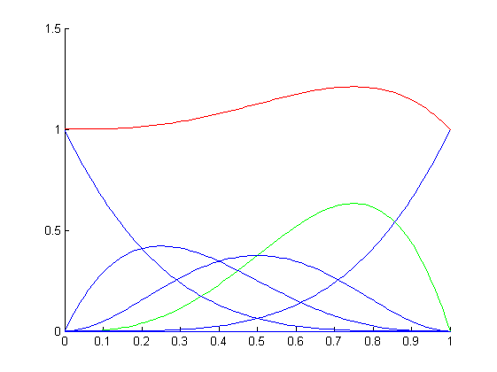
Properties of Bernstein polynomials
Effect of changing scaling factors A
A = [1 1 0.5 1 1]
A = [1 1 1 1 1]
A = [1 1 1 1.5 1]
General smoothness of the function is dependent on the degree (higher degrees create waviness)
Continuously differentiable curves can be obtained for any order of the Bernstein polynomials and any value of the scaling factors

Slide 25
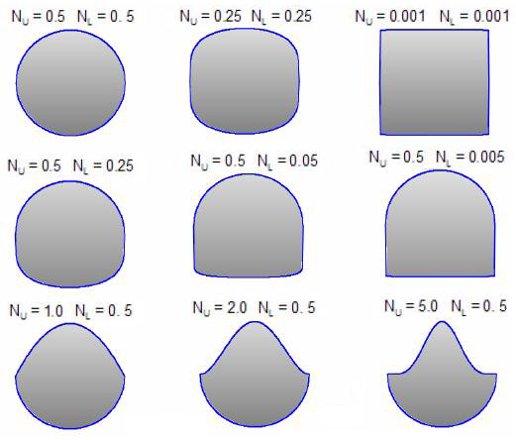
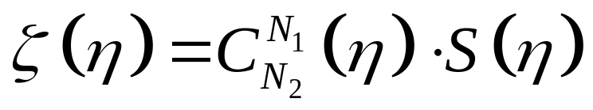
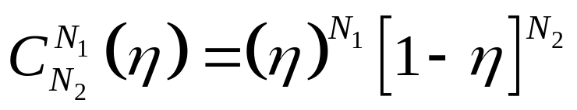
The class shape transformation function (CST) for curve parameterization
The Class function/Shape function Transformation Method (CST-method) by Boeing is another way for curve parameterization.
With CST, a variety of shapes can be generated, as variations (morphing) of a limited number of specific class functions (C), by means of a shape function S :
Useful class functions to represent fuselage cross sections
Notes:
*ATTENTION: in the equation above the symbol η is used instead of the usual parameter t (actually used in previous equations). However, they are exactly the same thing!
ATT! In the picture on the right, the fuselage sections are defined using one class function for the upper part and one class function for the lower part. Since both the upper and lower curve are symmetrical, N1=N2=N_{U} for the upper part, and N1=N2=N_{L} for the lower part.
For a detailed description of the CST method, read
KULFAN, B. 2008. Universal Parametric Geometry Representation Method, Journal of Aircraft, 45-1, 142-158.
This paper is made available on BB, as well as a MATLAB implementation for the 2D case.
Consider that the first tutorial of the MDO module will concern with parameterization and you will make use of the CST method. The tutorial will start with a brief intro to the CST method, mainly based on this set of slides.

Slide 26
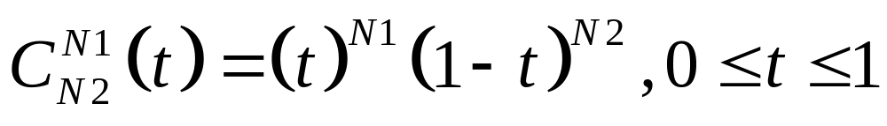
Class Functions
A Class function is a function that, even when multiplied by a Shape function, guarantees the presence of certain geometrical features
In other words, a Class function acts as a ‘template’ for the resulting output-function’s shape
A generic class function is given by:
where the coefficients N1 and N2 are responsible for the characteristic shape of the class function!

Slide 27
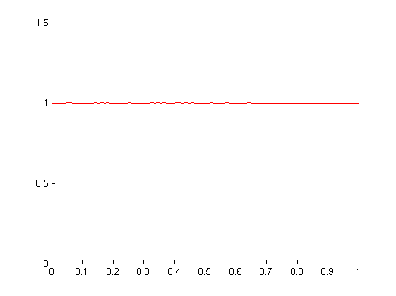
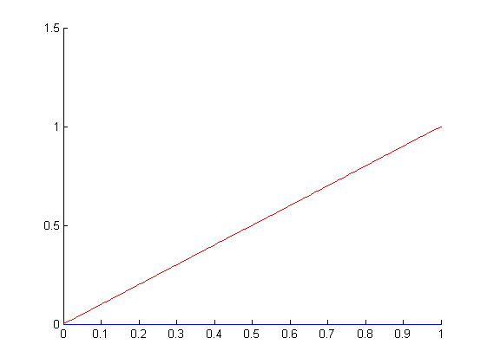
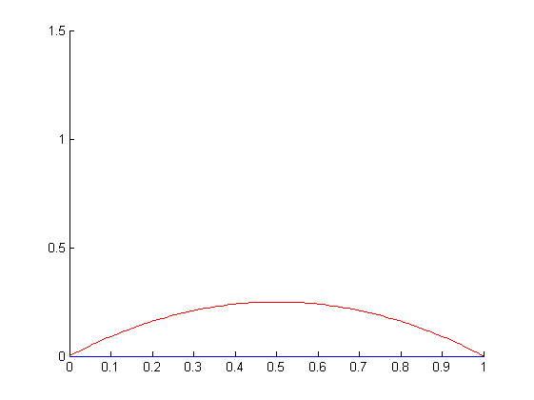
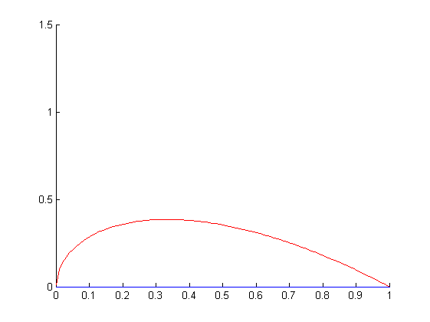
Class Functions
N₁=0 , N₂=0
N₁=1 , N₂=0
N₁=1 , N₂=1
N₁=0.5 , N₂=1
N₁=N₂=N_{U}=1

Slide 28
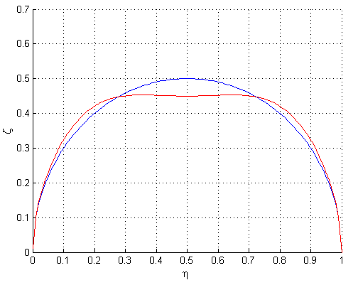
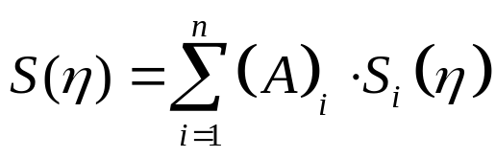
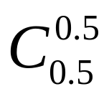
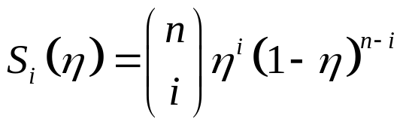
The class shape transformation function (CST) for curve parameterization
Bernstein polynomials are used as shape function S to morph the given class function C:
A=[1 1 1 1 1]
A=[1 1.4 0.2 1.4 1]
Bernstein polynomials
See the effect of changing the scaling vectors (A) of the Bernstein polynomials on a geometrical shape based on the shape function

Slide 29

Airfoil Class-function
The Class-function with N1=0.5 and N2=1 is of special interest.
It has a smooth nose and sharp tail section
By multiplying this class function C with any smooth Shape function S, the resulting curve will maintain the same properties.
In this fashion, feasible sub- / transonic airfoils are ensured, irrespective of the multiplying shape function
N₁=0.5 , N₂=1

Slide 30
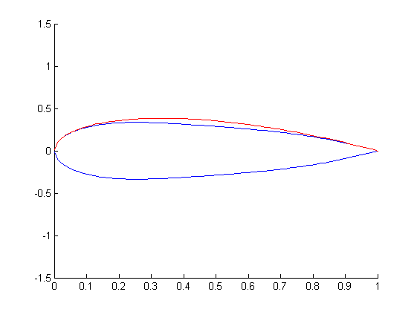
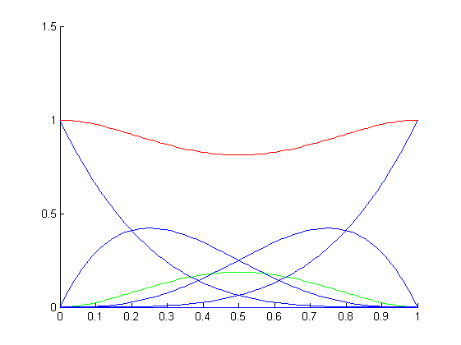
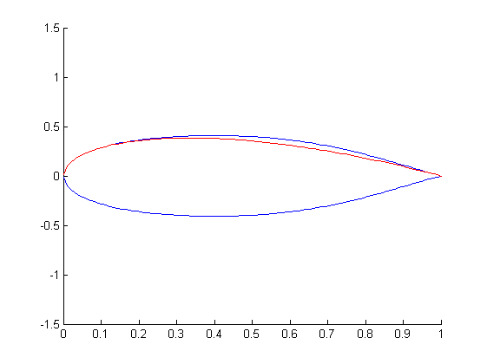
The CST transformation Method in action on a profile
=
X
=
X

Slide 31
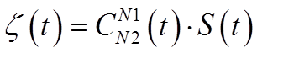
Recap on the CST method
The CST method is based on the following:
Definition of a parameterisation function, the Class function C, that always produces a feasible solution, of known properties
Definition of a function, the Shape function S (based on Bernstein polynomials), that modifies this class function without influencing its properties;
The class function restricts the set of possibilities to the ones of interest (i.e. an airfoil shape, with round nose and sharp boat tail)
The shape function provides changes, while maintaining the properties of the basis/class function and consequent design parameters

Slide 32
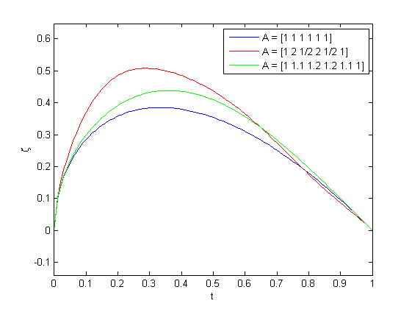
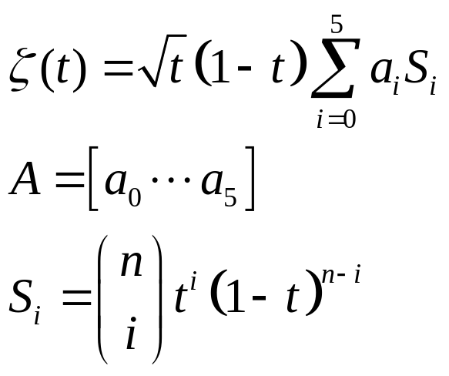
CST issues on local control
The CST method provides global control of the generated geometry, whereas local control is needed for more advanced design studies.
Changing one single coefficient (hence affecting only one of the B. polynomials), has an impact on the entire shape. The method lacks precise control in critical regions (e.g. LE region)
There is not one coefficient to control one given area/feature of the curve.

Slide 33
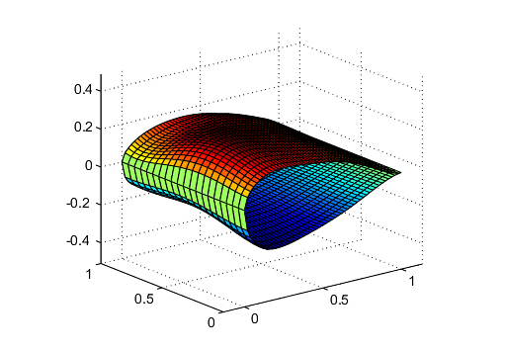
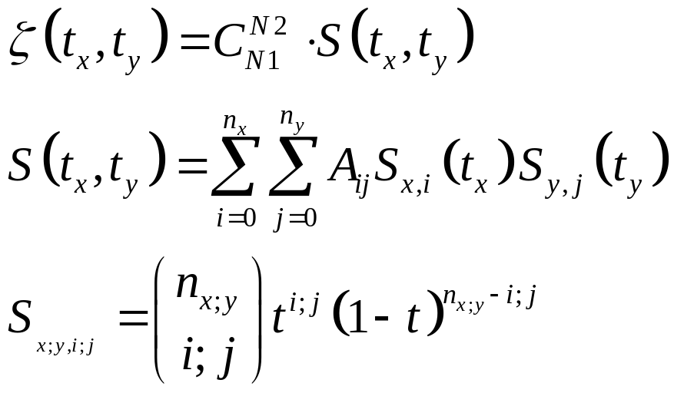
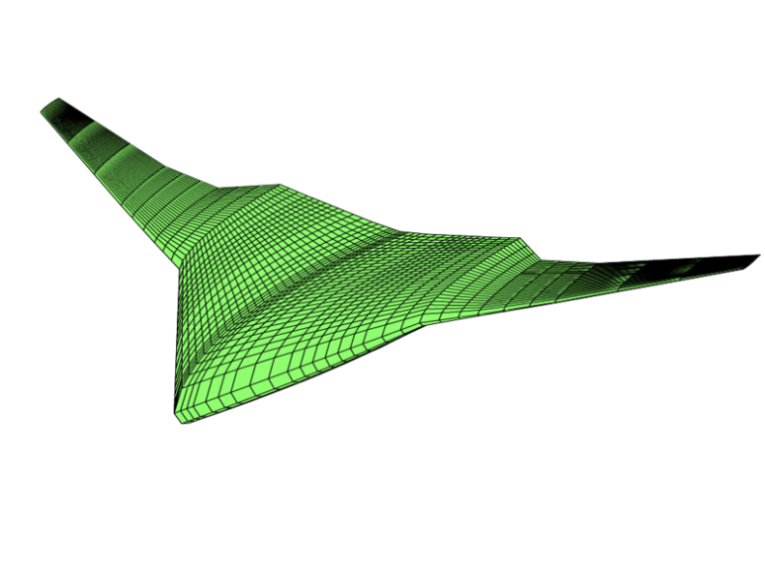
CST method extension for surface parameterisation
Example parameterization in
t_{x},t_{y} direction using Bernstein
Polynomials:

Slide 34


CST method extension for surface parameterisation

Slide 35


But, how can I use these parameterization techniques to represent the curve I want?
Say I have a certain airfoil that I want to parameterize, such that I can proceed with its optimization (e.g. minimum drag). How do I go about?
Imagine I use the following parameterization, based on Chebyshev polynomial:
How do I tune the coefficients α_{k}, such to model this, for example:

Slide 36

But, how can I use these parameterization techniques to represent the curve I want?
Suitable values of the α_{k} coefficients for a given curve can be found by minimizing the error between the expansion in Eq (4.1) and the curve, given as a set of N_{p} points (x_{n}, y_{n}).
The error may be represented by a quadratic error function, which depends on the basis function's coefficients α = (α₁, …,α₂):
Now, I can use an optimizer to minimize the objective function E, by changing the design variables α_{k}!
What am I actually doing here?
I make use of optimization – i.e. minimize the objective E(α) - to find a suitable initial set of design variables α, ….in order to start another optimization problem (e.g., minimize drag…)

Slide 37

But, how can I use these parameterization techniques to represent the curve I want?
Some indicators for the number of design variables required to describe an airfoil
N_{p}: nr of points (x_{n}, y_{n}) used for the initial curve definition (many!!)
N_{D}: nr of basis function coefficients (few!!)

Slide 38
Conclusions
Parameterisation is the actual means to translate a real system in the computational domain. As such, it is the first step towards the application of the MDO approach
In a multidisciplinary environment, the definition of one “Meta-representation” from which various model inputs can be derived, is a convenient way to provide consistency of the various disciplinary views
A proper geometric parameterisation allows the exploration of large design spaces, by means of a limited amount of parameters, while guaranteeing the generation of only usable and meaningful shapes

